Slide 1
Stylometry and Authorship
Ellen Slocum

Slide 2
What is Stylometry?
Stylometry is typically the statistical analysis of written language.
Stylometry is used to:
Determine authorship
Forensic applications
Applications in music and fine art
Major Assumption: Authors have a style
We all use Stylometry
Reading
Music
Artwork
Notes:
This style cannot be consciously manipulated and can be quantified.
We all use stylometry, when reading two papers we can typically tell the difference between two authors, we notice repeated words and other stylistic pieces.

Slide 3
History of Stylometry
Major Problem: no consensus as to correct methodology or technique
Big names in Stylometry:
Thomas Mendenhall, American Physicist
George Udny Yule, British Statistician
George Zipf, American Linguist
Computational Stylometry
Classic Example:
Analysis of the Federalist Papers
Authorship was disputed
Notes:
Stylometry involves applying math to ideas that
Many people feel that
Stylometry really takes off and is much more possible thanks to computers

Slide 4
Visual Stylometry
Visual Stylometry is the statistical analysis of visual arts
Paintings
Drawings
Known as attribution or authentication
Big name in Visual Stylometry: Daniel Rockmore
Professor of Mathematics, Dartmouth College
Sees this as a tool “deconstruct art”
“We construct a compact model of the statistics from such a multi-scale, multi-orientation image decomposition, and look for consistencies and inconsistencies across different drawings or paintings, or within a single work”
Notes:
Often instead of the word “authorship” you will hear…

Slide 5
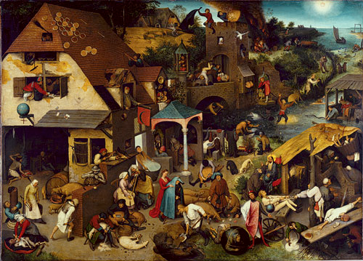
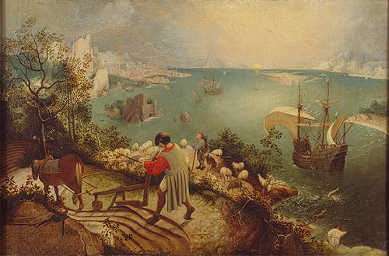
An Example of Visual Stylometry
Empirical Mode Decomposition
Example seen in the analysis of the works of Pieter Bruegel the Elder
Lived from around1525-1569
Painter/Drawer
From the Netherlands
Major works: Netherlandish Proverbs (1559) and Fall of Icharus (1568)
Still active debates regarding the authenticity of certain works previously attributed to Bruegel

Slide 6
Study Details
Examined 13 landscapes that were at one time attributed to Bruegel
Created a computer program to analyze pen strokes and characterize Bruegel’s “style” → This is where the math comes in
Begin with digital scans of each piece
Each piece is converted to greyscale (shades from black to white)
Central 2000*2000 pixel square is extracted
This square is then divided again into 25, 400*400 pixel squares
A grand total of 325 square samples were then run through the program

Slide 7
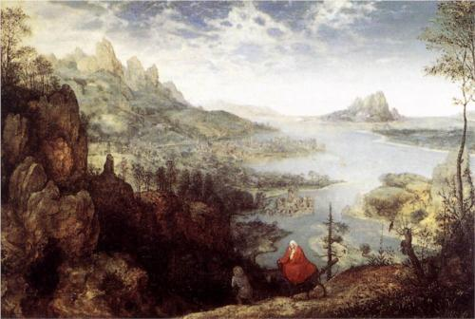
H
O
W
T
H
I
S
W
O
R
K
S

Slide 8
Mathematical Process
Through this process, images are digitized, analyzed, searched, and plotted→ process examines brushstrokes
1. Take a 20 mp photo of the drawing or painting
2. Divide image into squares, convert to greyscale, label each square 0-225 (Black-White)
3. Computer program searches for patterns in the horizontal, vertical, an diagonal brushstrokes
This is done 7 times
4. Reduce this information into a point on a 3D grid
5. The grid contains the works of many other artists, works by the same artist should cluster together

Slide 9
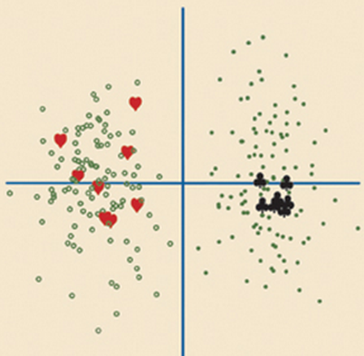
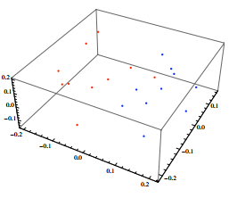
A 3D plot may look something like this
Black and Red = Known works

Slide 10
Behind the Computers: EMD and IMF
Uses ideas contained in Abstract Algebra and advanced Statistics
EMD-

Slide 11
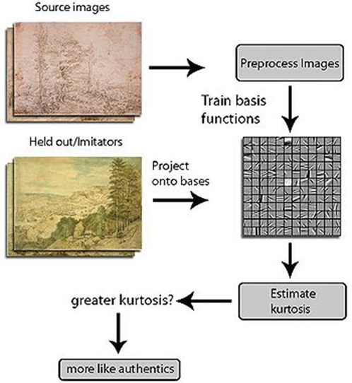
The Statistics Involved

Slide 12
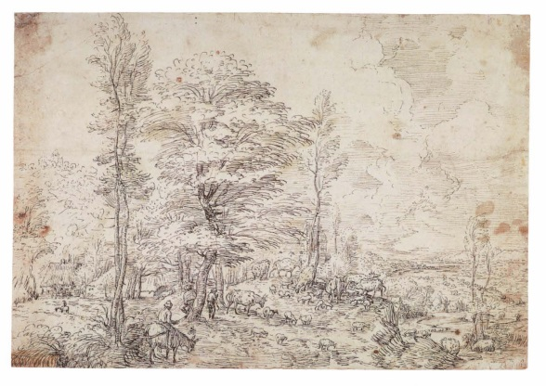
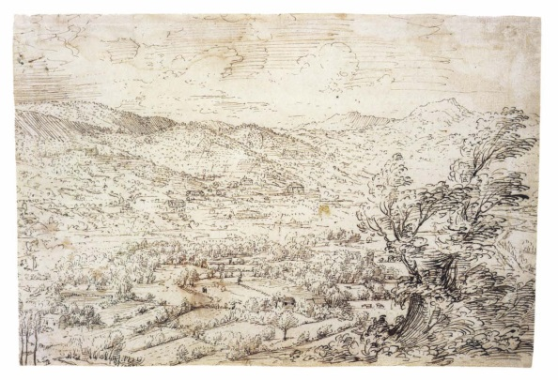
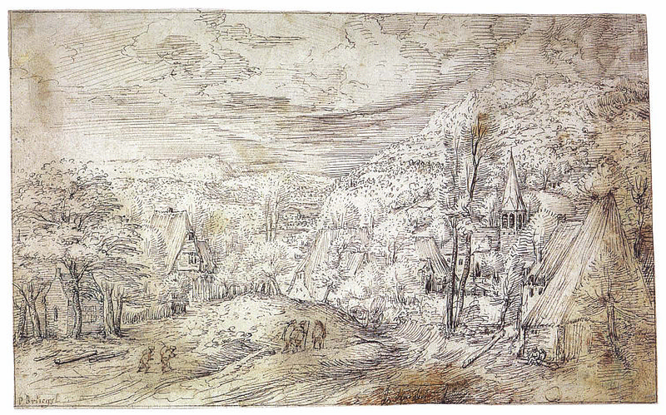
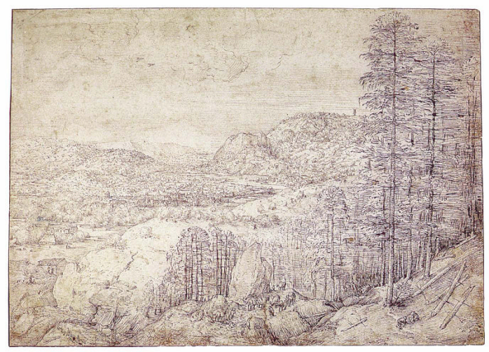
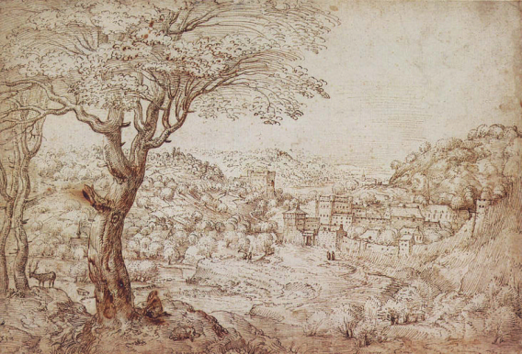
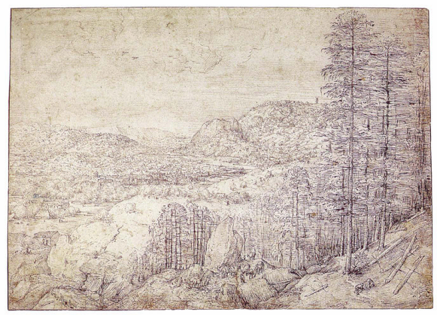
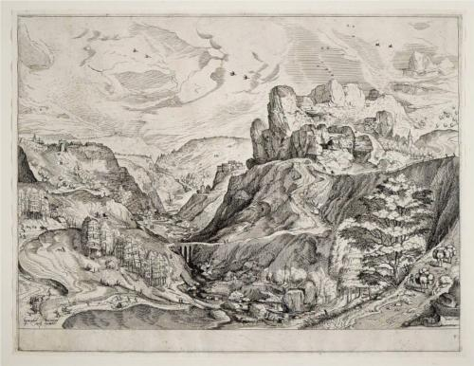
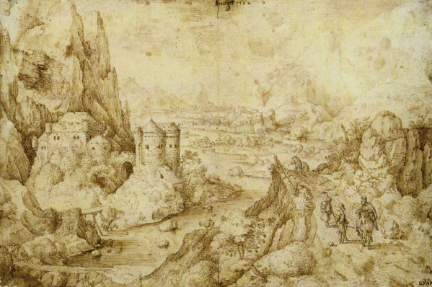
The Debated Works…
IMITATION
IMITATION
IMITATION

Slide 13
Applications in Education:
Lesson 1: Box and Whisker charts
Grades 9-12
Students compare 2 known writing samples and 1 unknown sample to identify the author of the unknown sample using box and whisker charts and a graphing calculator.
Lesson 2: Graphing and Statistics
Grades 7-9
Students use passages from several different texts and use them to
graph the distribution of word length
graph the distribution of sentence length
find average word length and sentence length
compare graphs to help identify which passages are from the same author

Slide 14
References
http://www.math.msu.edu/~ywang/Preprints/EMD_Bruegel-2-20-2011.pdf
Numb3rs Activity Article
http://www.kw.igs.net/~bkiggins/#stylometry
The Evolution of Stylometry In Humanities Scholarship
Empirical Mode Decomposition Analysis for Visual Stylometry
http://www.npr.org/templates/story/story.php?storyId=123405424
http://math2033.uark.edu/wiki/index.php/Visual_Stylometry
http://web.archive.org/web/20060630113842/chronicle.com/temp/reprint.php?id=4fvlt82gn640d1rp48srbpjsvlzhmyrs
http://homepage.univie.ac.at/daniel.graham/SPIE2010_print_JH.pdf
https://www.sciencenews.org/article/teaching-computer-spot-bogus-bruegel
http://www.ima.umn.edu/~arnold/press/star-tribune-02-12-06.html

